Slide 1







Autonomous Air transportation
AC Design
Using Vision Navigation
Flight test
Autopilot
Introduction
Implementation
Computer Vision
Supervised by: Asst. Prof. Osama Saaid

Slide 2
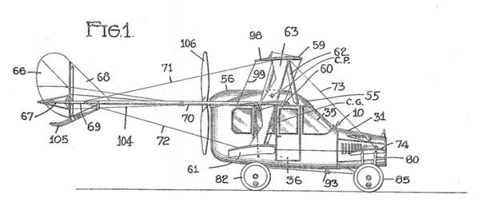

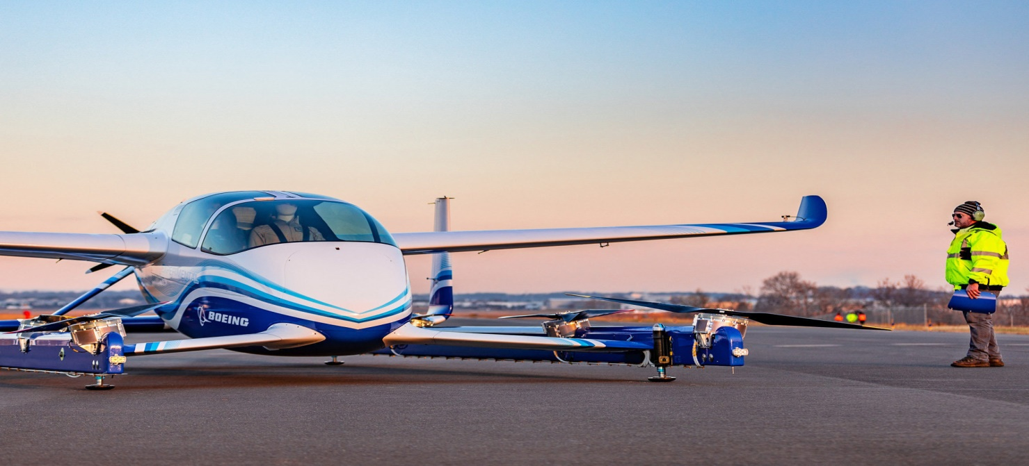
Flying Taxi
According to AIR&SPACE magazine in April 2018 ,Prof. Vikas Prakash defined it as:
a flying vehicle with a range of 50 to 120 miles, carrying one to four passengers, and cruising at an altitude of 3,000 to 5,000 feet.
Introduction

Slide 3
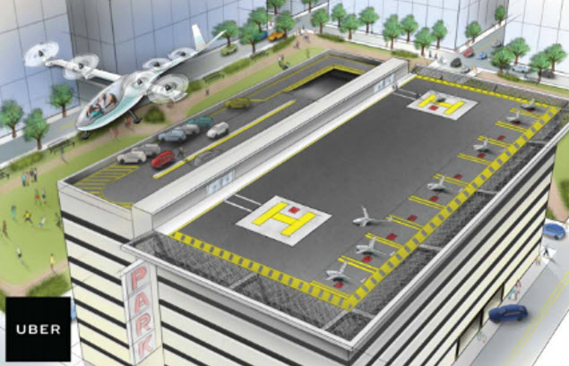
Why attractive idea
Traffic jam problem
Infrastructure cost
Reduce emission and improve safety
Obstacles we need to pass
Introduction
Energy limitations
The public is ready to fly aboard an air taxi with no pilot
Our current air traffic control systems doesn’t accommodate air taxies

Slide 4

Flying taxi categories
Passenger drone:
Electric or hybrid electric
Move people or cargo
Manually piloted, remotely piloted or fully autonomous
Cover short to medium range up to 65 miles
will take flight by 2020
Introduction

Slide 5
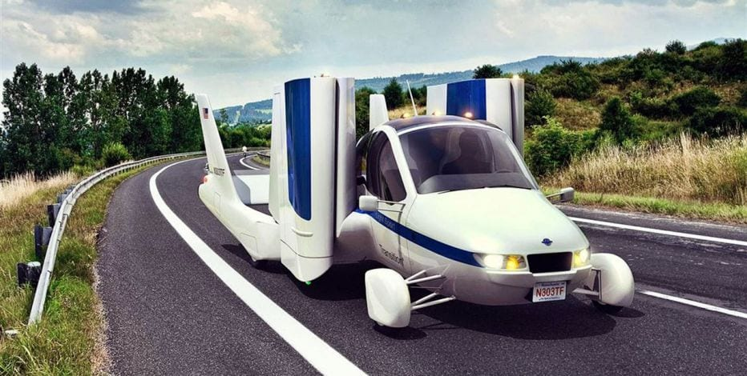
Flying taxi categories
Traditional flying cars:
Can be driven in car configuration to the airport then change it to airplane mode
Need licensed pilot
Cover medium to long range
will take flight by 2020-2022
Introduction

Slide 6
Flying taxi categories
revolutionary vehicles:
combine a passenger drone and traditional flying car
Fully autonomous vehicle
Cover long range (greater than 200 miles)
Have advanced VTOL capability
It could take until 2025 before they become a reality
Introduction

Slide 7
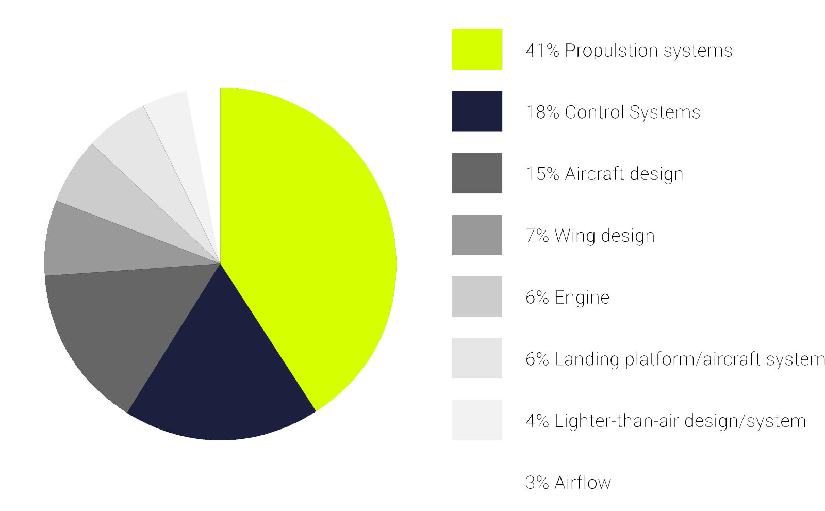
Technology areas dominating air taxi technology
Introduction

Slide 8






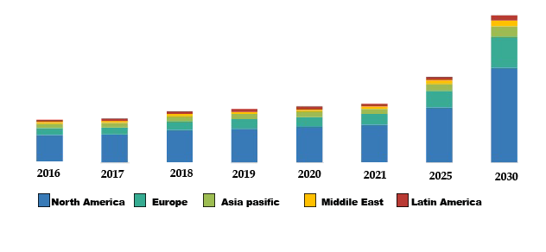
The key players in the flying car space
Introduction

Slide 9

The key players in the flying car space
Boeing flying taxi:
Has completed the first test of its autonomous electric VTOL
Introduction

Slide 10
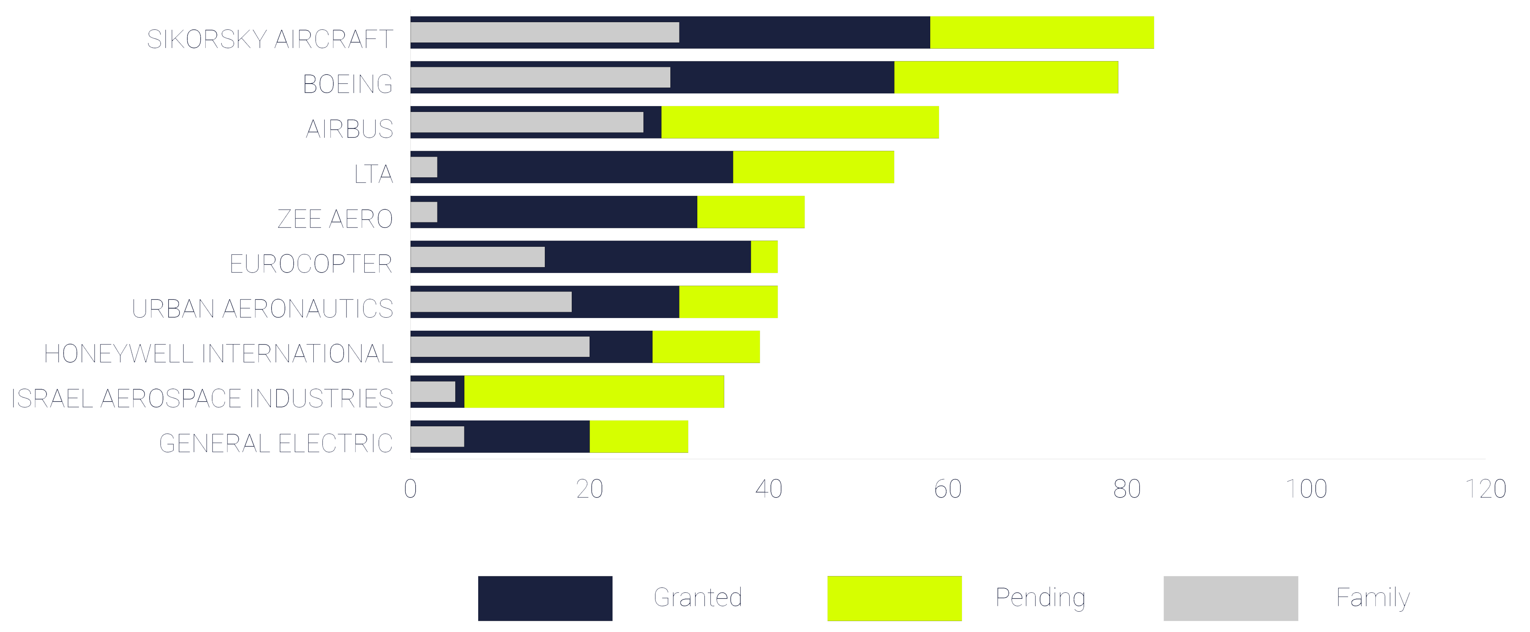
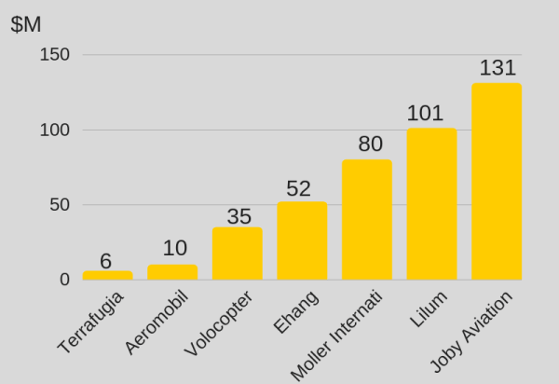
The key players in the flying car space
Introduction

Slide 11
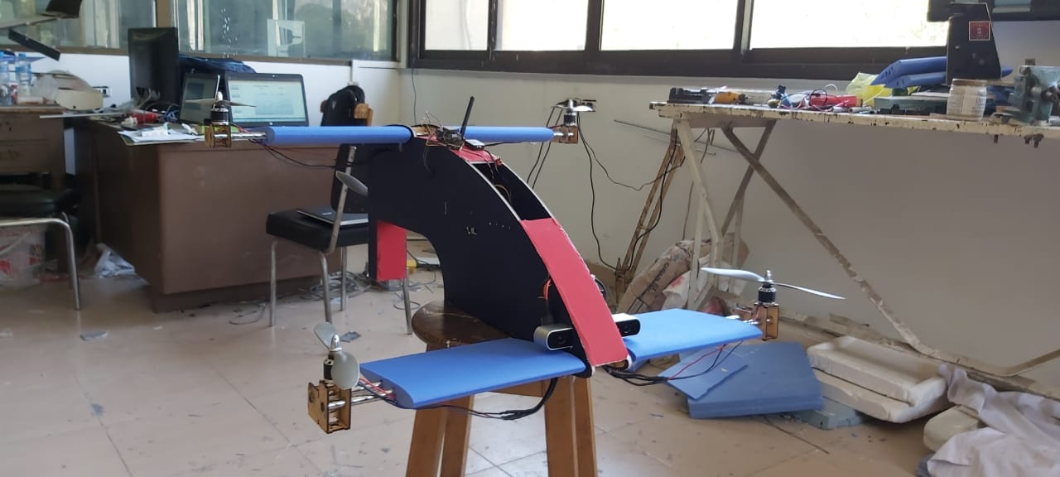
Our prototype
Introduction

Slide 12

Mission
AC Design
Autonomous air transportation using vision navigation

Slide 13
Why Quad-plane?
POC | Fixed-wing | Multi-copter | Quad-plane
Vertical takeoff and landing | No | Yes | Yes
Comfortable | Yes | No | Yes
Power consumption | Low | High | Low
Cruise speed | High | Low | High
Endurance | Long | Short | Long
Range | Long | Short | Long
AC Design

Slide 14
Scaled model
Why?!
A 1/100 scaled model based on payload
AC Design
A full scaled model
A 1/100 scaled model
80 kg passenger
20 kg luggage
20 kg navigation equipment
1.2 kg
1/100

Slide 15
Mission
Payload
Payload | total estimated weight (gm)
Passenger | 200
Chair | 100
electronics | 300
Rasperry pi 2 | 42
XPAL power supply | 517
Pixhawk | 38
Jetson Kit | 431
RP Lidar A1 | 190
ZED camera | 159
Total mass | 2000 gm
AC Design

Slide 16
Payload optimization
Payload | weight (gm) | Optimized payload | Optimized weight
Passenger | 200 | Passenger | 200
Chair | 123 | Chair | 123
electronics | 300 | Electronics | 300
Rasperry pi 2 | 42 | - | 0
XPAL power supply | 517 | - | 0
Pixhawk | 38 | Pixhawk | 38
Jetson Kit | 431 | Mini Jetson Kit | 150
RP Lidar A1 | 190 | - | 0
ZED camera | 159 | ZED camera | 159
Total mass | 2000 gm | Total mass | 970 gm
AC Design

Slide 17
Sizing
Mission
Main payload
AC Design
VTOL Propulsion system
New Payload
MTOM
Fixed-wing
sizing

Slide 18
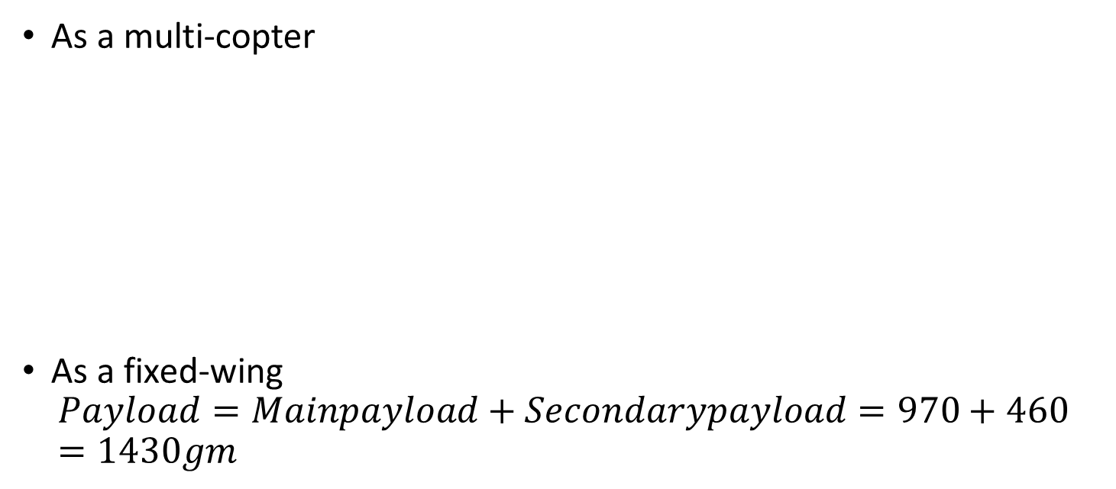
Sizing
As a multi-copter
As a fixed-wing
$$Payload=Mainpayload+Secondarypayload=970+460=1430gm$$
component | Mass of a piece | No of pieces | Total mass
VTOL motors | 71 | 4 | 284
VTOL propellers | 19 | 4 | 76
VTOL ESC | 25 | 4 | 100
Total mass | - | - | 460 gm

Slide 19
Propulsion system selection
AC Design
Autonomous air transportation using vision navigation

Slide 20
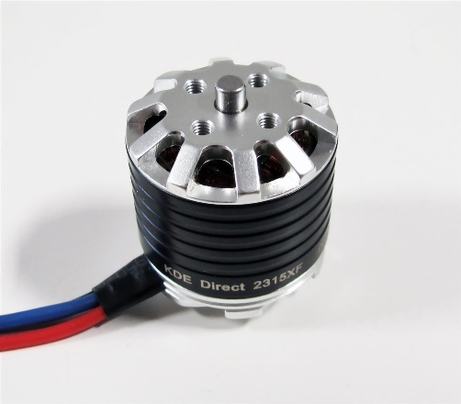
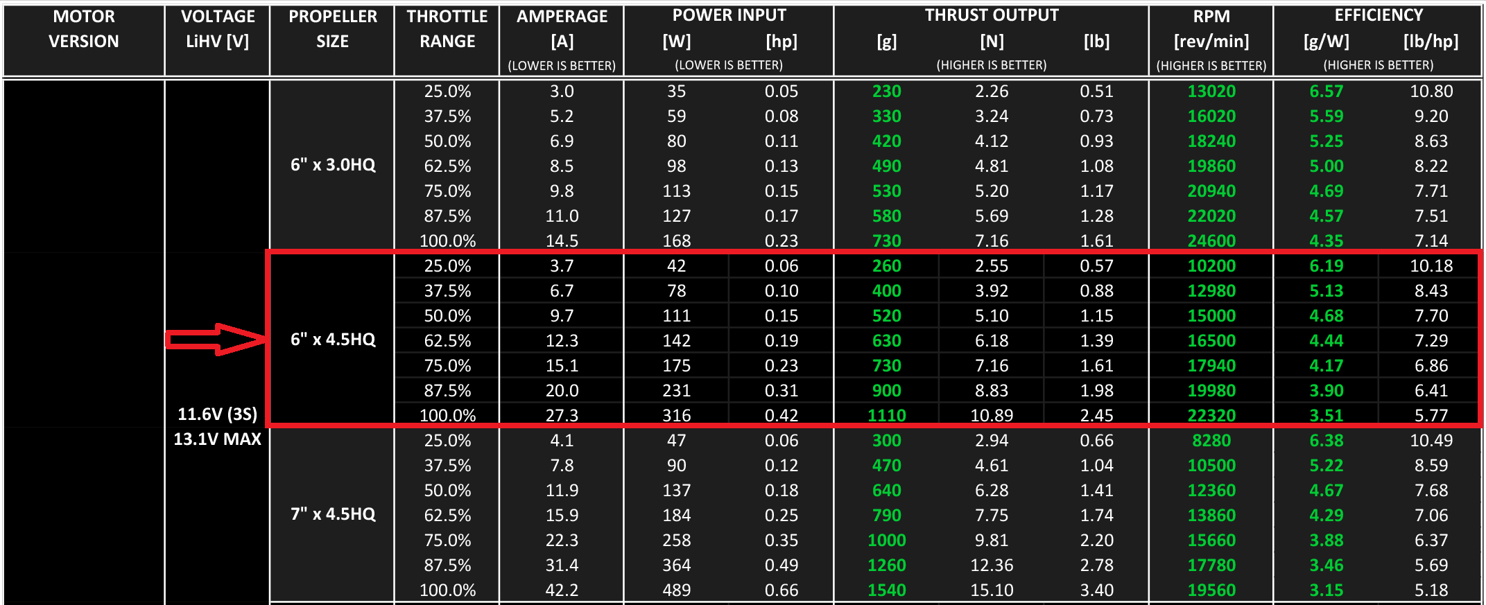
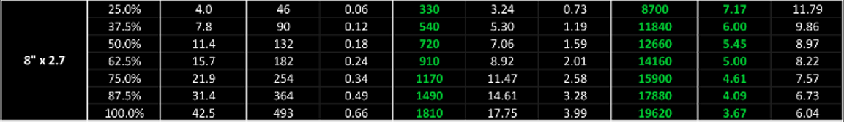
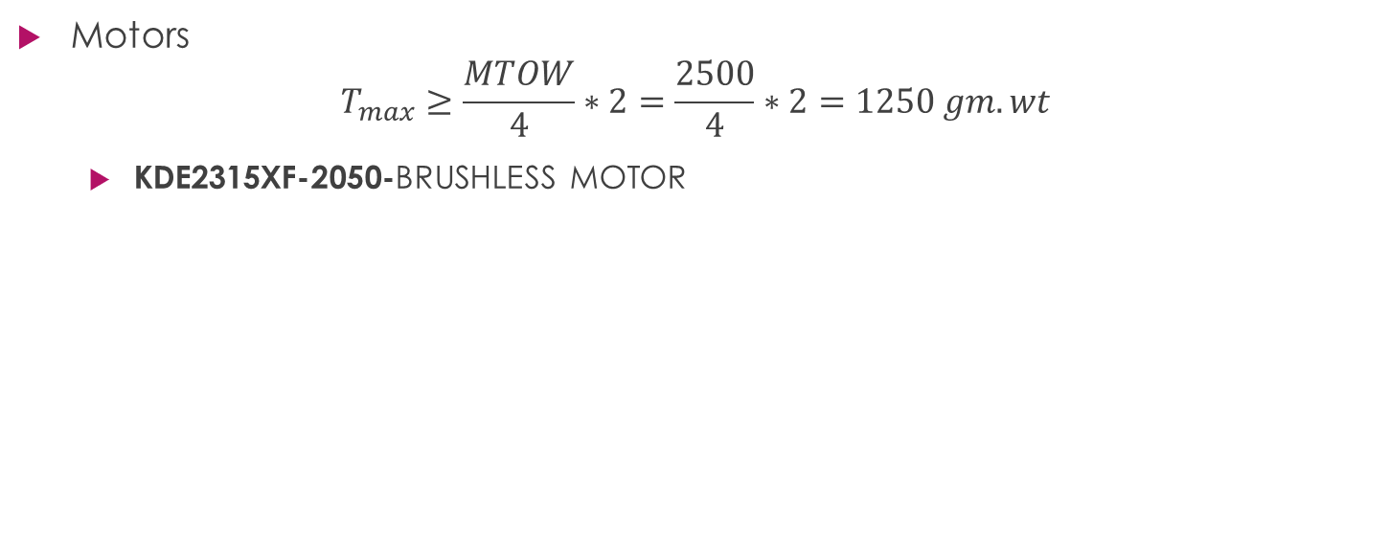
VTOL
Motors
$$T_{max}≥\frac{MTOW}{4}∗2=\frac{2500}{4}∗2=1250 gm.wt$$
KDE2315XF-2050-BRUSHLESS MOTOR

Slide 21
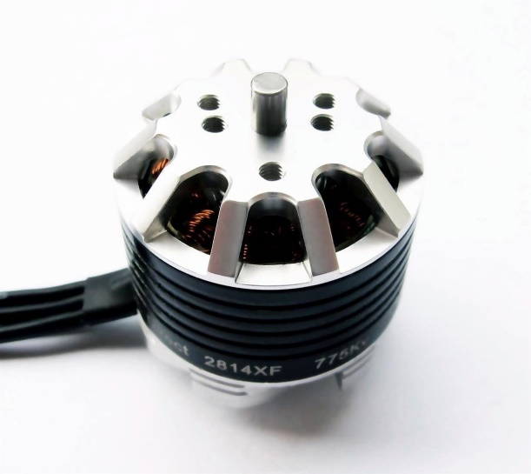
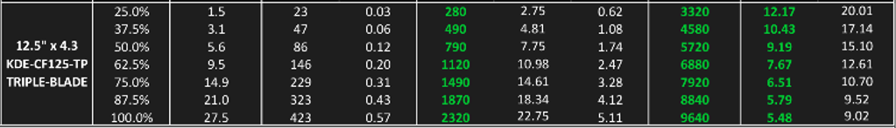
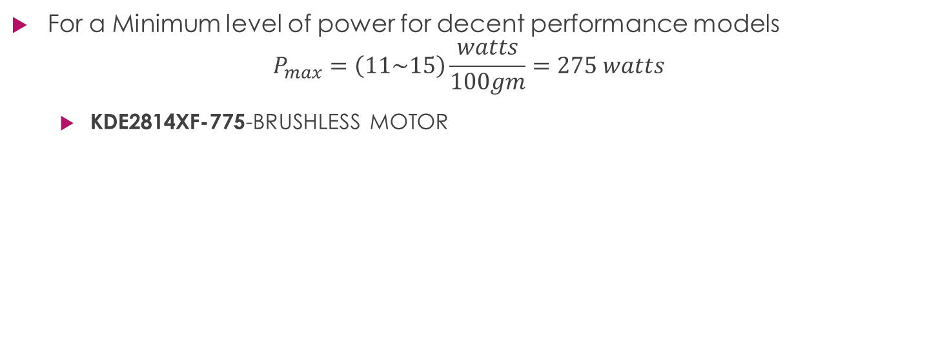
Cruise
For a Minimum level of power for decent performance models
$$P_{max}=\left(11\sim 15\right)\frac{watts}{100gm}=275 watts$$
KDE2814XF-775-BRUSHLESS MOTOR

Slide 22
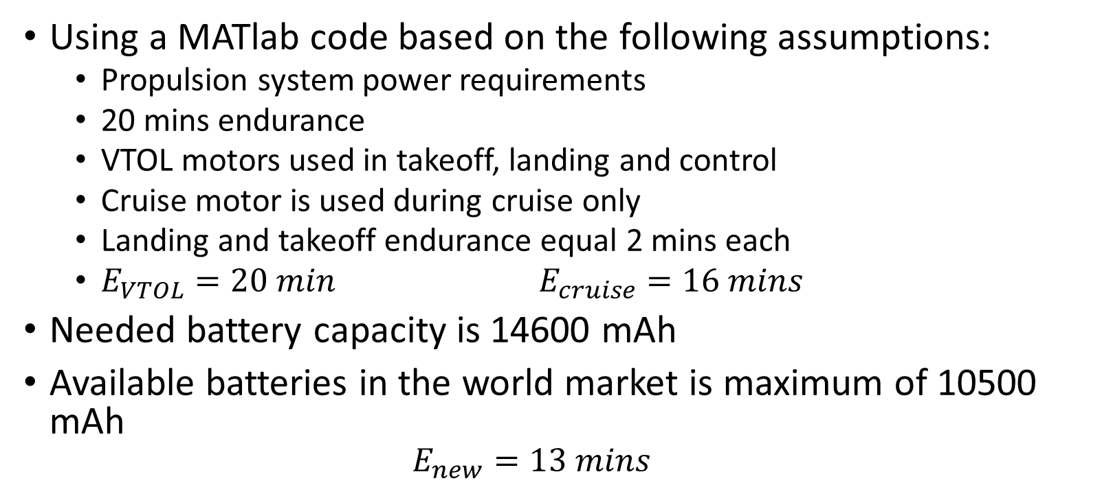
Battery
Using a MATlab code based on the following assumptions:
Propulsion system power requirements
20 mins endurance
VTOL motors used in takeoff, landing and control
Cruise motor is used during cruise only
Landing and takeoff endurance equal 2 mins each
$E_{VTOL}=20 min$ $E_{cruise}=16 mins$
Needed battery capacity is 14600 mAh
Available batteries in the world market is maximum of 10500 mAh
$$E_{new}=13 mins$$
AC Design

Slide 23
Due to limited resources
AC Design
Autonomous air transportation using vision navigation

Slide 24
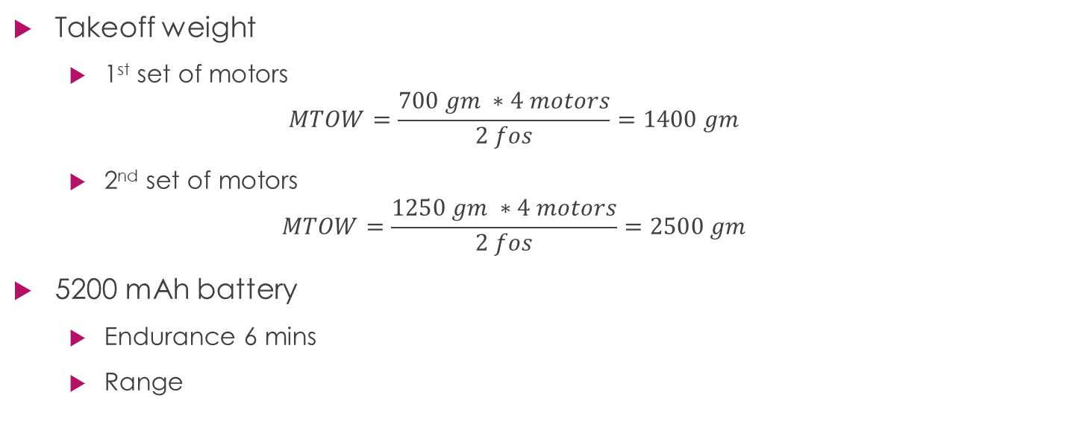
Propulsion system limitations
Takeoff weight
1st set of motors
$$MTOW=\frac{700 gm ∗4 motors}{2 fos}=1400 gm$$
2nd set of motors
$$MTOW=\frac{1250 gm ∗4 motors}{2 fos}=2500 gm$$
5200 mAh battery
Endurance 6 mins
Range
AC Design

Slide 25
Vehicle design
Before designing the vehicle, goals, mission and constraints must be defined well to achieve the highest performance and efficiency:
Mission
Flying taxi which takeoff and landing at streets of the city
Constraints
Max. takeoff weight about 3 Kg.
Max. wide of vehicle 0.8 meter.
Minimum length for easy landing at any place.
AC Design

Slide 26
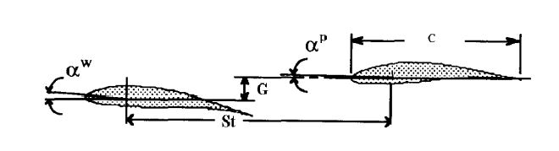

Wing configuration
Design parameters of Tandem wing plane
AC Design
Stagger ($St$)
Gap ($G$)
Decalage ($δ=α^{ω}−α^{p}$)

Slide 27
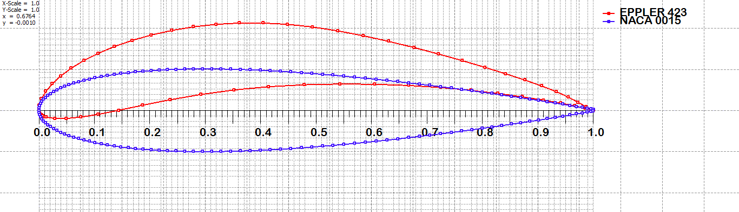
Design Criterion
Airfoil selection
AC Design
Eppler423 (higher lift)
NACA0015 (easy to manufacture)

Slide 28
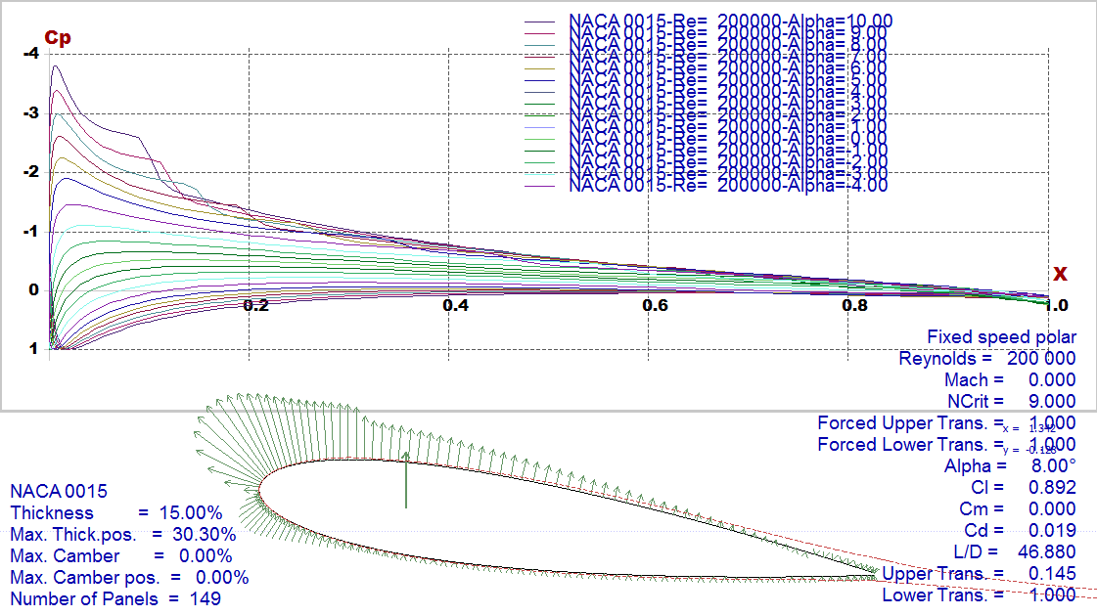
Analyzed airfoils
NACA0015
AC Design

Slide 29
Analyzed airfoils
NACA0015
AC Design

Slide 30
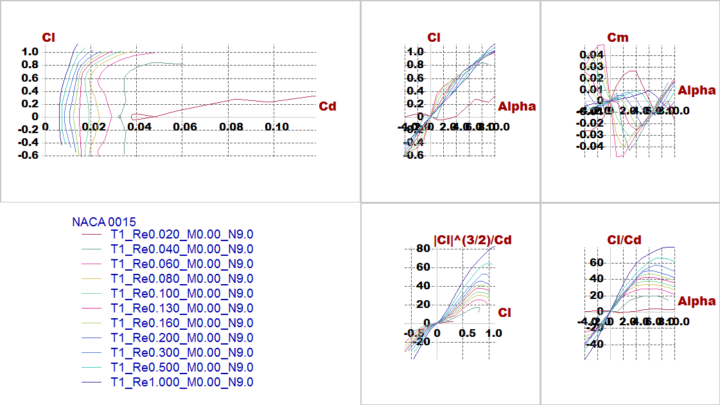
Analyzed airfoils
NACA0015
AC Design

Slide 31
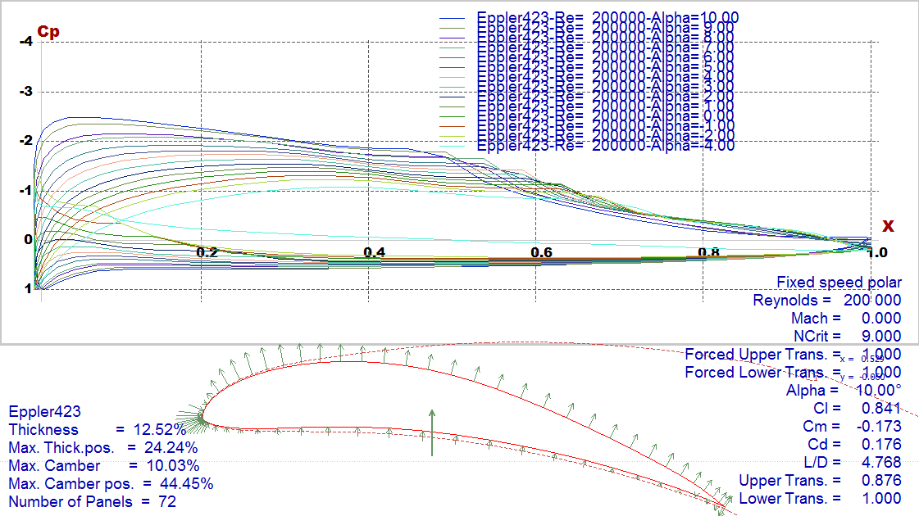
Analyzed airfoils
Eppler423
AC Design

Slide 32
Analyzed airfoils
Eppler423
AC Design

Slide 33
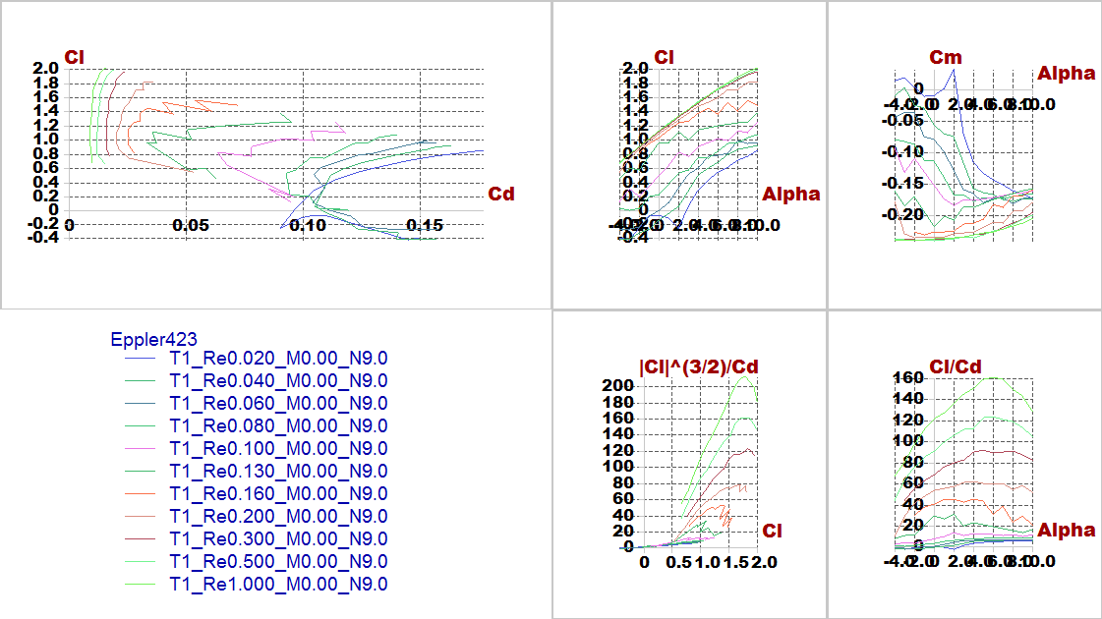
Analyzed airfoils
Eppler423
AC Design

Slide 34
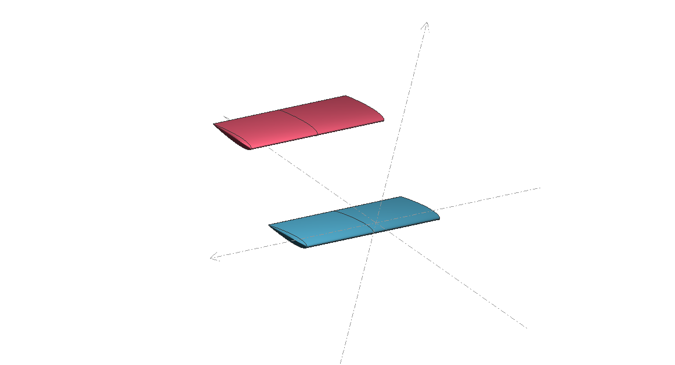
Aerodynamic analysis
After trying different trials considering constraints and requirements, the best configuration has been chosen then stability and lift produced is checked.
AC Design

Slide 35
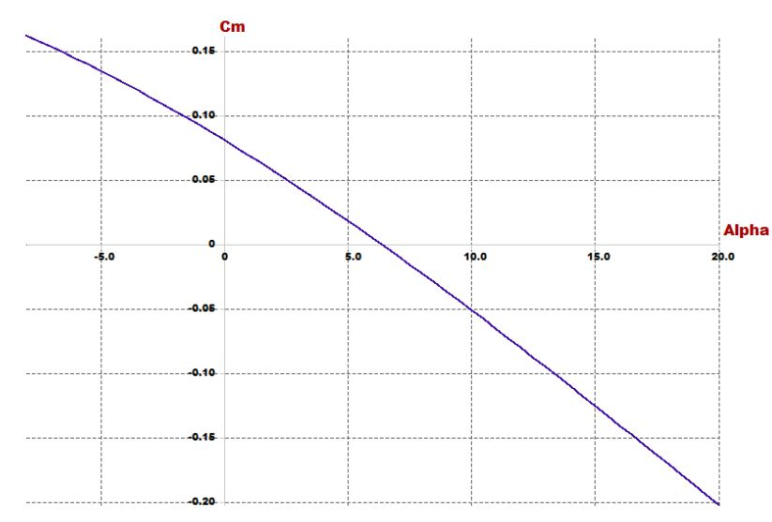
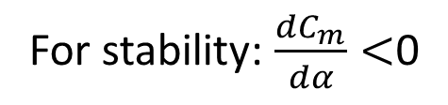
Investigating goals and requirements
For stability: $\frac{dC_{m}}{dα}<$0
AC Design

Slide 36
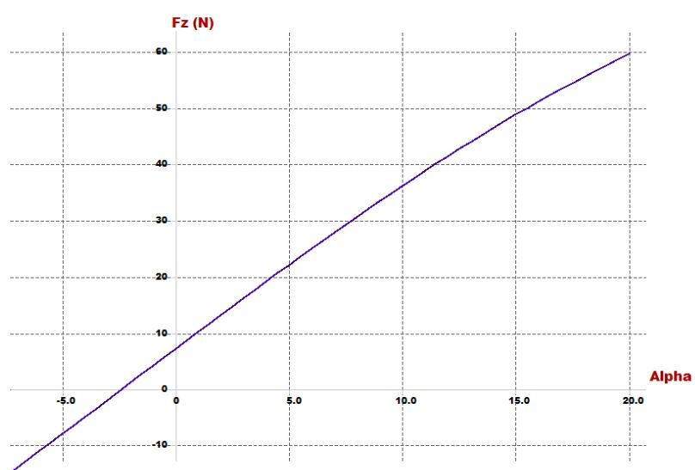
Investigating goals and requirements
For lift: At trim angle the lift must carry the vehicle
AC Design

Slide 37
Design parameters
In this part stability of quad-plane is checked and the airfoil design parameters (incidence angle, CG position, cruise speed and dimensions of wings) is chosen
Parameter | Effect on the vehicle
Span | proportional with lift
Chord | proportional with lift
Cruise speed | proportional with lift
Arm | Static stability
Incidence angle | Static stability
Position of CG | Static stability
Position of second wing | Static stability
AC Design

Slide 38
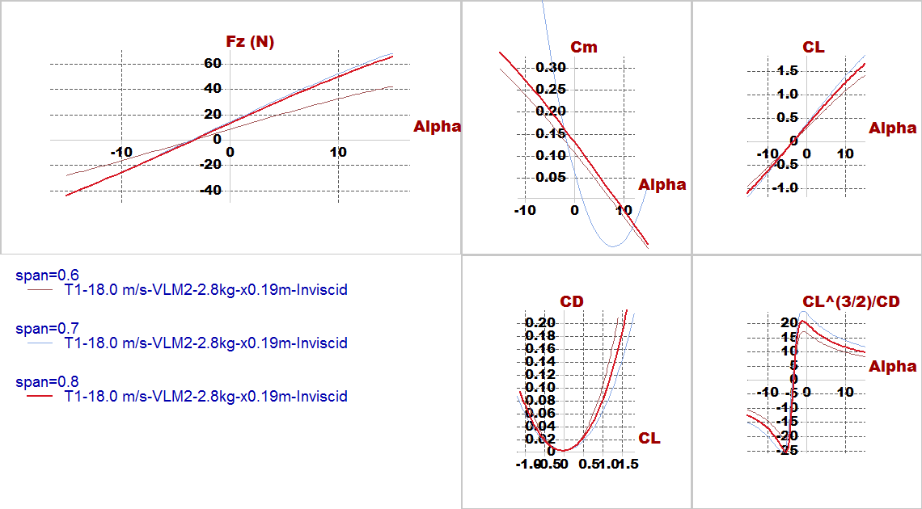
Effect design parameters
Span
AC Design

Slide 39
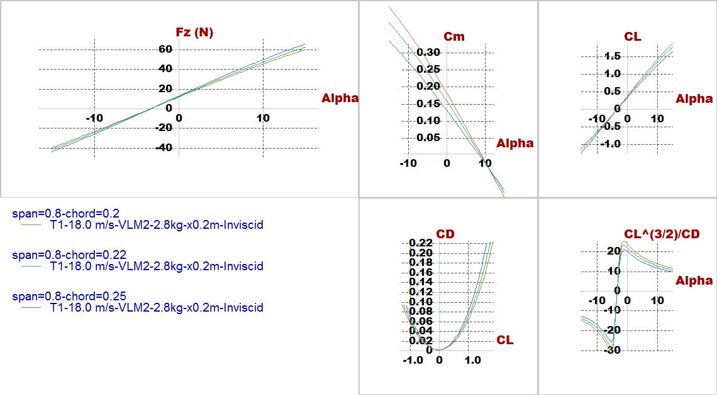
Effect design parameters
Chord
AC Design

Slide 40
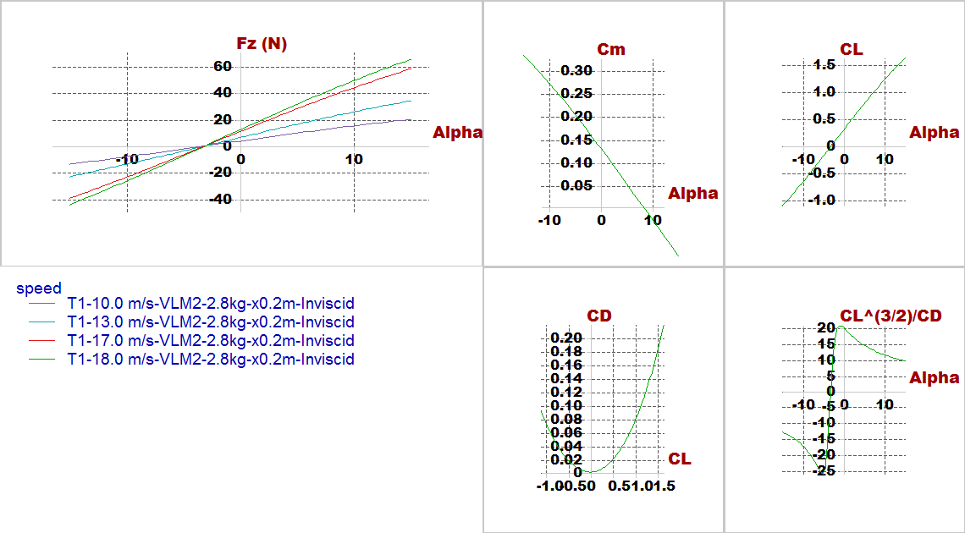
Effect design parameters
Cruise speed
AC Design

Slide 41
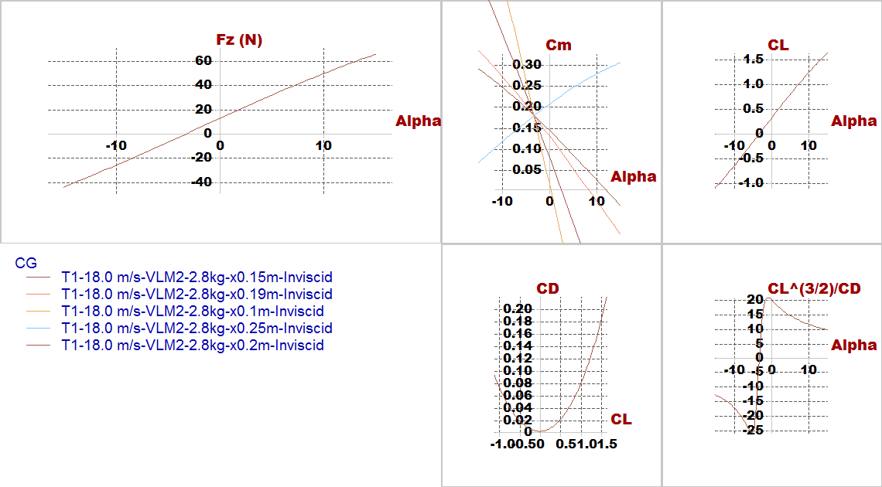
Effect design parameters
C.G.
AC Design

Slide 42
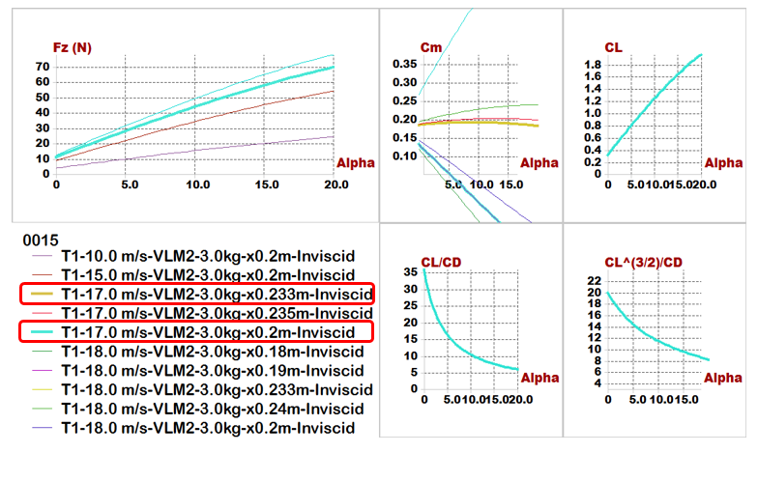
Results
Plane analysis(NACA0015)
AC Design

Slide 43
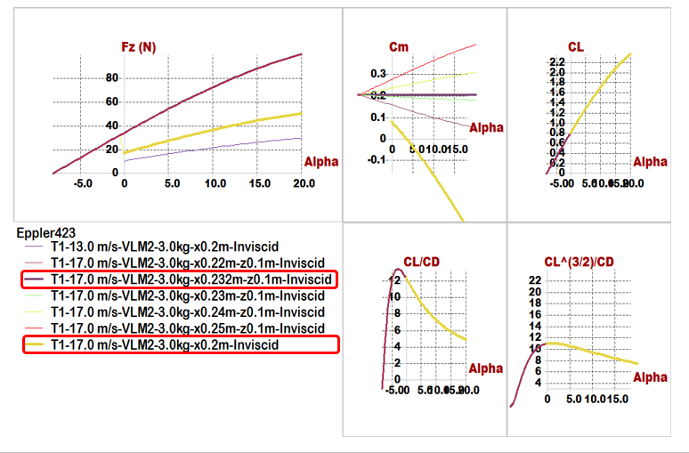
Results
Plane analysis(Eppler423)
AC Design

Slide 44
Quick comparison between 2 airfoils
Comparisons \ Models | Model 1 (NACA0015) | Model 2 (Eppler423)
Position of Main wing | x= 0, z= -0.05 m | x= 0, z= -0.05 m
Position of Second wing | x= 0.45 m, z= 0.1 m | x= 0.45 m, z= 0.15 m
Span | 0.8 m | 0.6 m
Chord | 0.25 m | 0.2 m
Aspect ratio | 3.2 | 3
Cruise speed | 17 m/s | 17 m/s
Incidence of Main wing | 5 degree | 3 degree
Incidence of Second wing | 2 degree | -8 degree
Trim angle | 5.1 degree | 3.6 degree
𝑿_𝑪.𝑮 | 0.19 m | 0.2 m
𝑿_𝑵.𝑷 | 0.233 m | 0.25 m
Degree of Static Stability (S.M.) | 17.2% | 25%
AC Design

Slide 45
Optimization for aerodynamic stability
In this phase trying to put point of C.G. in the middle of the vehicle to equalize the value of moments resulting from two wings to optimize the (𝐶𝑚−𝛼) graph, PX4 requirements, easy to manufacturing and high accuracy results during assembly.
Parameter | Effect on the vehicle
Span | proportional with lift
Chord | proportional with lift
Cruise speed | proportional with lift
Arm | Static stability
Incidence angle | Static stability
Position of second wing | Static stability
AC Design

Slide 46
Optimization for aerodynamic stability
Comparisons \ Models | Model (NACA0015)
Position of Main wing | x= 0 , z=0
Position of Second wing | x= 0.6 m , z= 0.3 m
Span of main wing | 0.6 m
Span of second wing | 0.75 m
Chord of main wing | 0.2 m
Chord of second wing | 0.22 m
Aspect ratio | 3.2
Cruise speed | 18 m/s
Incidence of Main wing | 9 degree
Incidence of Second wing | 8 degree
Trim angle | 0.3 degree
𝑿_𝑪.𝑮 | 0.36 m
Z_𝑪.𝑮 | 0.15 m
𝑿_𝑵.𝑷 | 0.381 m
Degree of Static Stability (S.M.) | 10.5%
Reylonds number | About (100,000 to 200,000)
AC Design

Slide 47
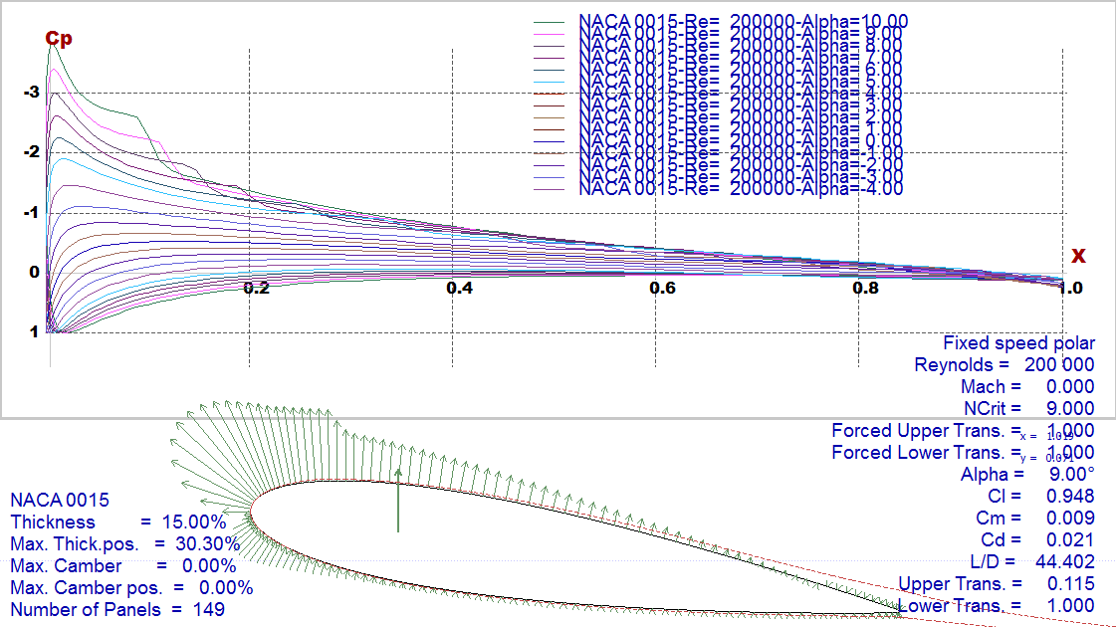
Final Results
Foil characteristics
AC Design

Slide 48
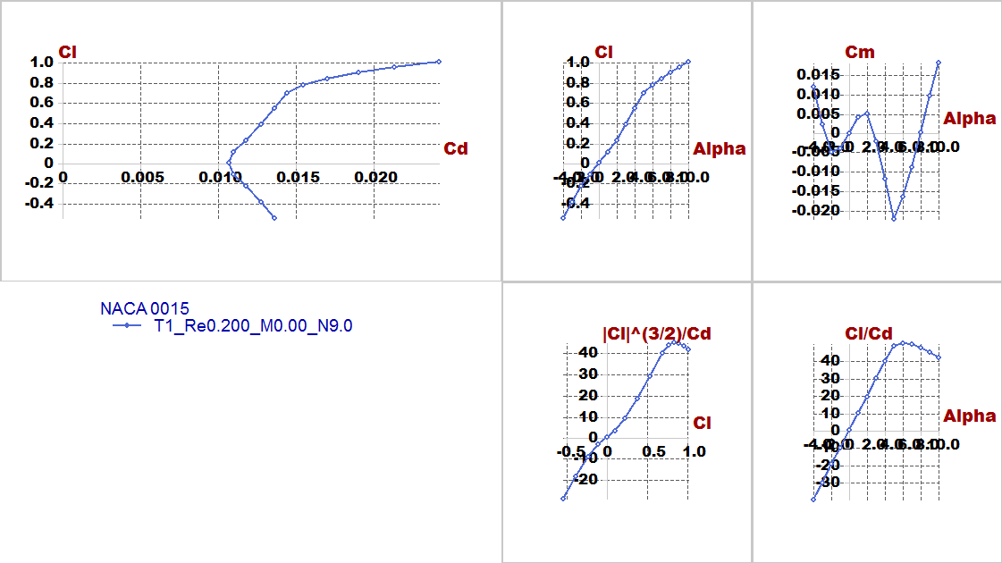
Final Results
Foil characteristics
AC Design

Slide 49
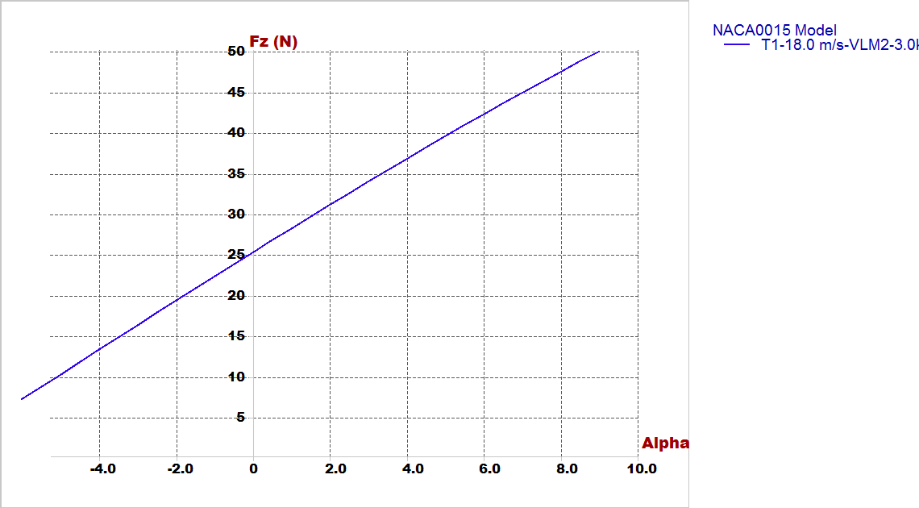
Final Results
2. Lift Vs alpha
AC Design

Slide 50
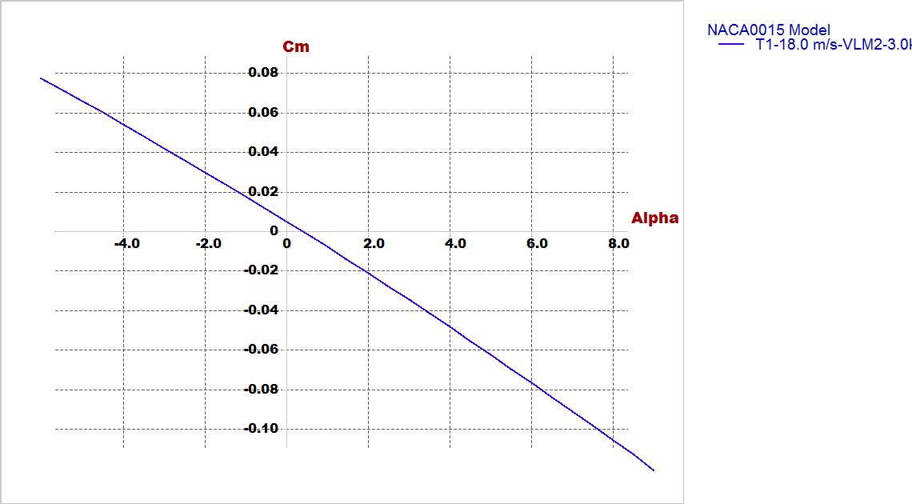
Final Results
3. Cm Vs alpha
AC Design

Slide 51
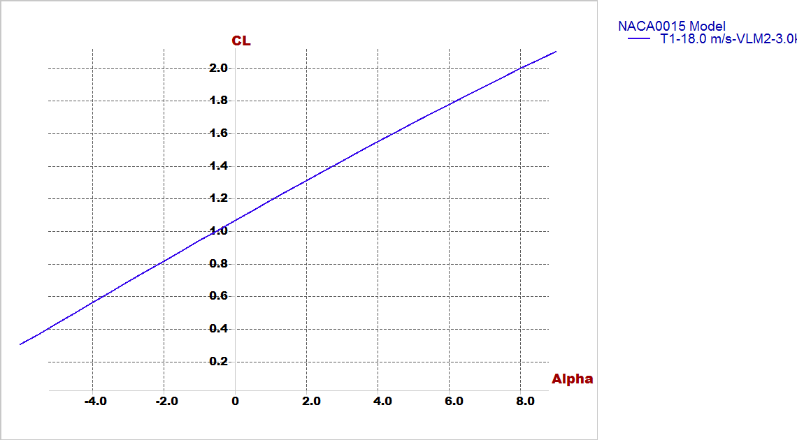
Final Results
4. Cl Vs alpha
AC Design

Slide 52
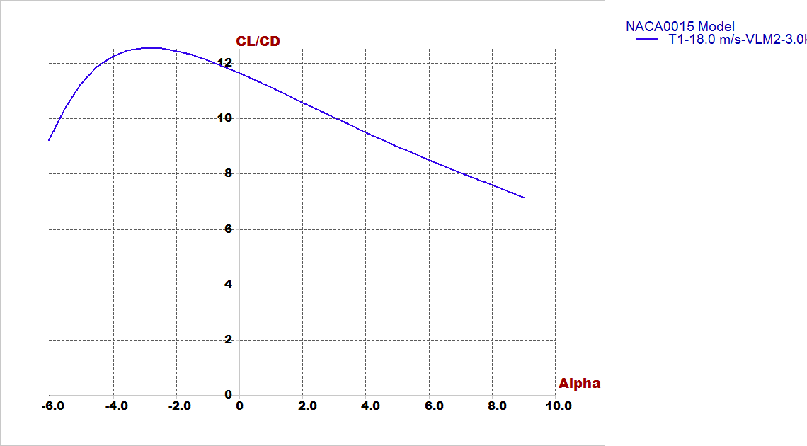
Final Results
5. Cl/Cd Vs alpha
AC Design

Slide 53
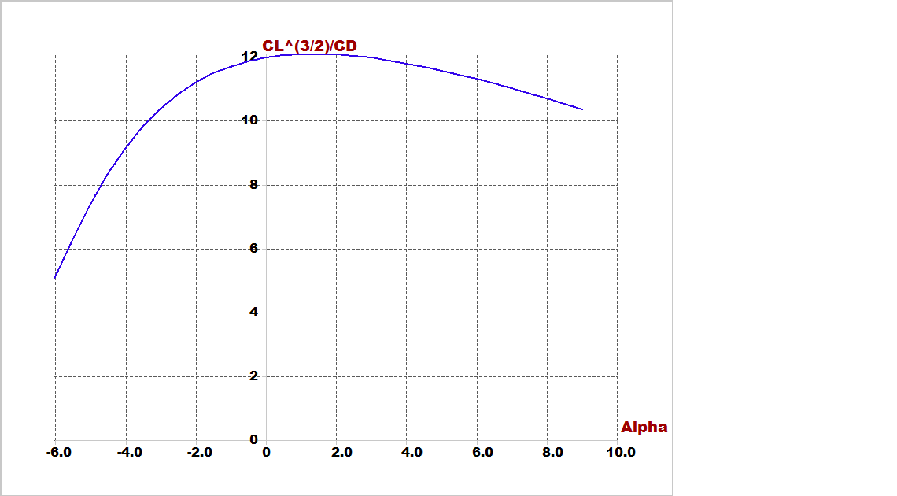
Final Results
6. Cl^(3/2)/Cd Vs alpha
AC Design

Slide 54
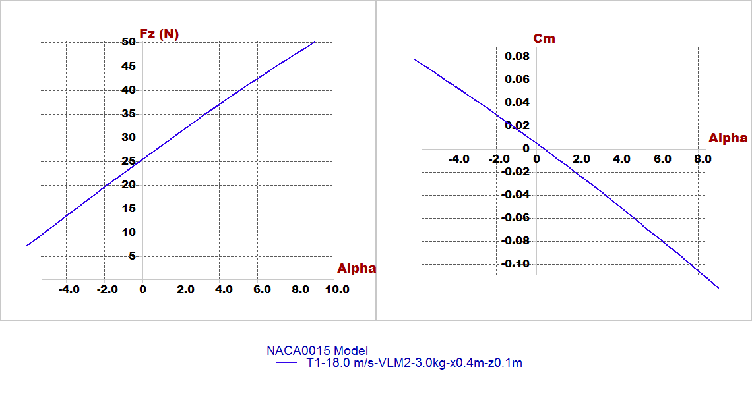
Stability Analysis
In experimental design checking for results very important by focus on 2 important figures:(longitudinal static stability and lift generated from airfoil)
AC Design

Slide 55
Stability Analysis
We will illustrate this part by video its shown modes of longitudinal and lateral stability of plane by root locus and time response.
B. For lateral:
Type1: roll damping.
Type2,3: Dutch roll mode.
Type4: spiral mode.
For longitudinal:
Type1: short period mode.
Type2: Pitching.
Type3,4: motion around steady state flight.
AC Design

Slide 56
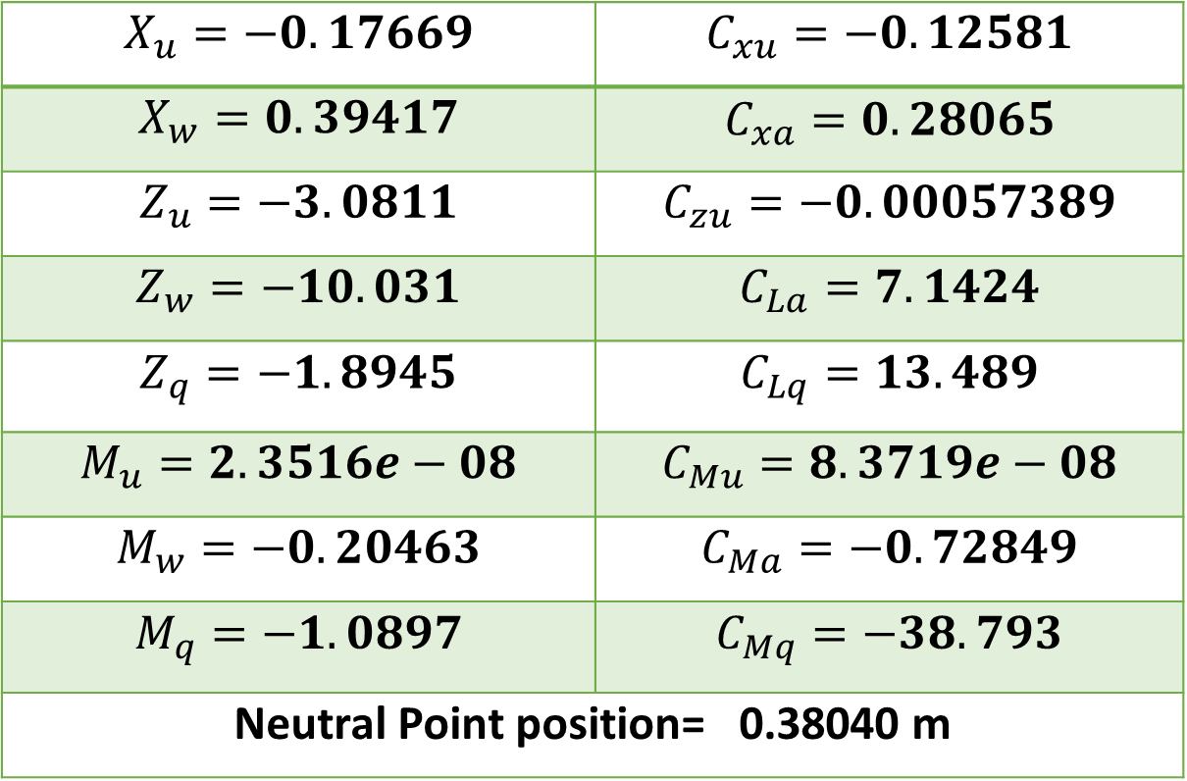
Stability Analysis
Longitudinal derivatives from Xflr5:
$$X_{u}=−0.17669$$ | $$C_{xu}=−0.12581$$
$$X_{w}=0.39417$$ | $$C_{xa}=0.28065$$
$$Z_{u}=−3.0811$$ | $$C_{zu}=−0.00057389$$
$$Z_{w}=−10.031$$ | $$C_{La}=7.1424$$
$$Z_{q}=−1.8945$$ | $$C_{Lq}=13.489$$
$$M_{u}=2.3516e−08$$ | $$C_{Mu}=8.3719e−08$$
$$M_{w}=−0.20463$$ | $$C_{Ma}=−0.72849$$
$$M_{q}=−1.0897$$ | $$C_{Mq}=−38.793$$
Neutral Point position= 0.38040 m
AC Design

Slide 57
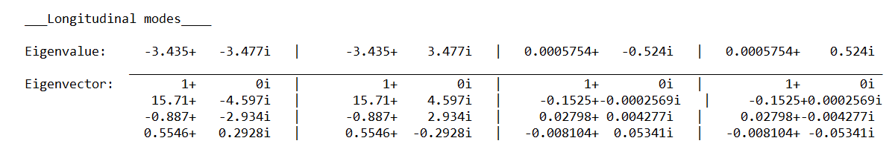
Stability Analysis
Root locus for longitudinal:
AC Design

Slide 58
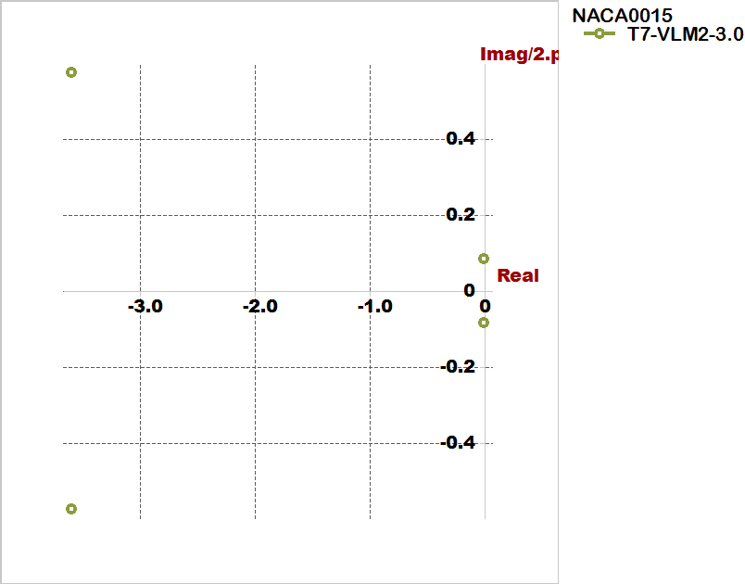
Stability Analysis
Root locus for longitudinal:
AC Design

Slide 59
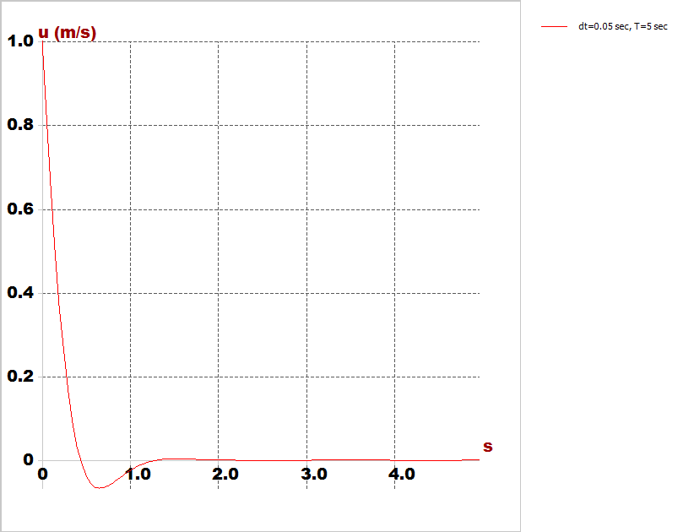
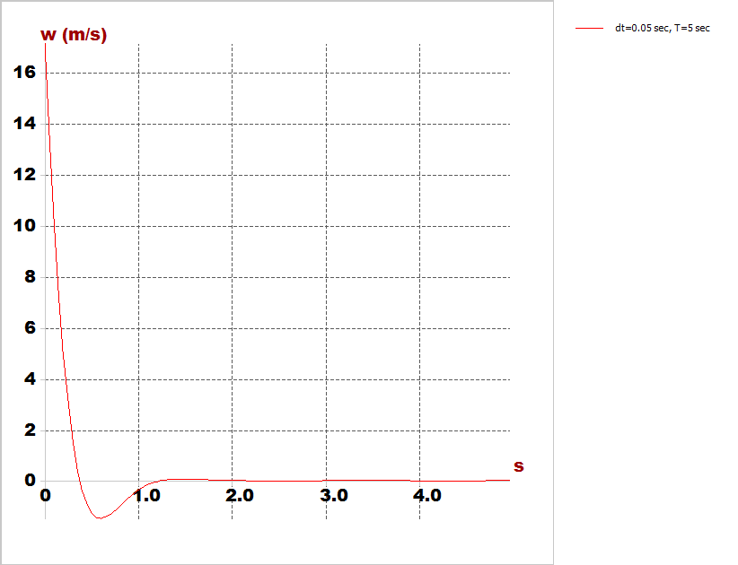
Stability Analysis
Time response characteristics:
Longitudinal response modes
Horizontal speed response
Vertical speed response
AC Design

Slide 60
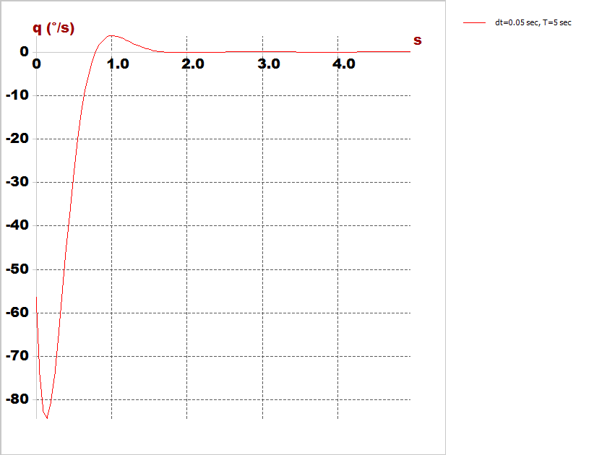
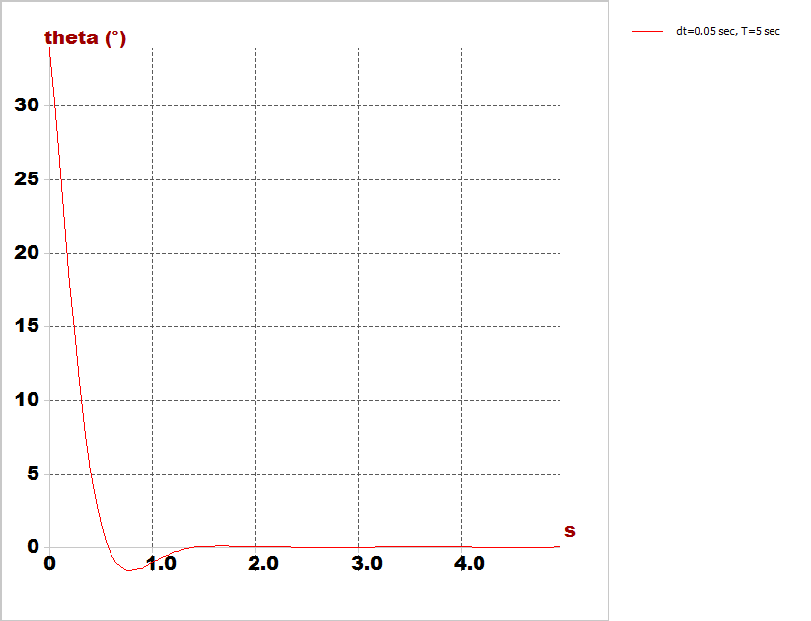
Stability Analysis
Time response characteristics:
Longitudinal response modes
Pitch rate
Pitch angle
AC Design

Slide 61

Stability Analysis
Longitudinal response modes
AC Design

Slide 62

Stability Analysis
Lateral derivatives from Xflr5
$$Y_{V}=−1.4123$$ | $$C_{Yb}=−1.0055$$
$$Y_{P}=−0.00051128$$ | $$C_{Yp}=−0.0012135$$
$$Y_{r}=0.51861$$ | $$C_{Yr}=1.2309$$
$$L_{V}=−0.078116$$ | $$C_{lb}=−0.092699$$
$$L_{P}=−0.23481$$ | $$C_{lp}=−0.92883$$
$$L_{r}=0.11081$$ | $$C_{lr}=0.43833$$
$$N_{V}=0.41621$$ | $$C_{nb}=0.49391$$
$$N_{P}=−0.047057$$ | $$C_{np}=−0.18614$$
$$N_{r}=−0.15671$$ | $$C_{nr}=−0.61988$$
AC Design

Slide 63

Stability Analysis
Root locus for lateral:
AC Design

Slide 64


Stability Analysis
Time response characteristics:
Lateral response modes
Cruise speed
Roll rate
AC Design

Slide 65


Stability Analysis
Time response characteristics:
Lateral response modes
Yaw rate
Bank angle
AC Design

Slide 66

Stability Analysis
Lateral response modes
AC Design

Slide 67
AC Design

Slide 68
AC Design

Slide 69
Mechanical design
AC Design
Autonomous air transportation using vision navigation

Slide 70
Machining constraints
Available machines
Laser cutter
Only cuts foam and wood sheets with maximum size of (80*50 cm)
CNC foam forming
Forms wings form foam using hot wire with moderate accuracy
3D printer (20*10*20 cm)
AC Design

Slide 71
Building a 3D mechanical model
Why SolidWorks
Steps to build a mechanical design
Define components geometry and mass properties
Define CG location resulted from XFLR5 analysis
Define geometric dimensions resulted from XFLR5 analysis
Define components position constraints (cameras, lidars and PIX4)
Take wiring clearance inconsideration
AC Design

Slide 72





Payload
AC Design

Slide 73





Propulsion system
AC Design

Slide 74



Design iterations
1st iteration
AC Design

Slide 75



Design iterations
2nd iteration
AC Design

Slide 76



Design iterations
3rd iteration
AC Design

Slide 77



Design iterations
4th iteration
AC Design

Slide 78



Design iterations
6th iteration
AC Design

Slide 79


Design iterations
7th iteration
AC Design

Slide 80
Design iterations
8th iteration
AC Design

Slide 81



Design iterations
9th iteration
AC Design

Slide 82



Design iterations
10th iteration
AC Design

Slide 83



Design iterations
11th iteration
AC Design

Slide 84

Autopilot

Slide 85

Computer Vision

Slide 86



Implementation
Why ROS ?
Implementation

Slide 87


some important features in ROS
ROS master
ROS nodes
ROS topics
ROS messages
ROS packages
ROS services
ROS actions
Implementation

Slide 88

increase our experience in ROS and Its features
Deferential Drive Robot (DD robot)
Implementation

Slide 89

Modeling
Objective
Control the DD robot linear velocity and angular velocity
Localize the DD robot by fusing the data from IMU and odometry from encoders
Implementation

Slide 90

Block Diagram
Implementation

Slide 91

1D Bi-rotor
validate ROS performance in aerospace applications
Block Diagram
Conjuration 1 (ROS PID) (Low-pass filter on derivative term)
Implementation

Slide 92

Controller Tuning in Real time
Implementation

Slide 93

Configuration 2 (PIDA)
Implementation

Slide 94

Results & Conclusions
Sampling Time
Comparison between configuration 1 and Configuration 2 sampling time
Implementation

Slide 95



Effect of not constant Sampling time
Put $K_{d}$=$K_{I}$=$K_{a}$=0 , $K_{p}$=value ,Hence Controller=$K_{p}=error=−K_{p}∗state$
Implementation
$$T_{s}=\text{Constant}$$

Slide 96


$$T_{s}≠\text{Constant}$$

Slide 97


Gains tuning (Comparing between ROS and my PID controller)
Implementation
(a) $K_{p}=60 , K_{I}=10 , K_{D}=30$, cutto-freq (Low pass lter on derivative term) = 40 Hz

Slide 98


Gains tuning (Comparing between ROS and my PID controller)
Implementation
(b) ${ROS pid K}_{p}=60 , K_{I}=15 , K_{D}=30$, cutto-freq (Low pass lter on derivative term) = 40 Hz ,and same gains for my PID but adding $K_{a}=10$ (to resist error acceleration)

Slide 99

Comparing between ROS and my PID controller on one graph
Implementation

Slide 100

Comparing between ROS and my PID controller on one graph
Implementation

Slide 101

PX4 autopilot(PX4 , ROS and Gazebo)
Implementation

Slide 102

MAVROS and MAVLink messages interpretation
Implementation

Slide 103
VIDEO Position control
Position Control Using(PX4,Gazebo simulation,MAVROS)
Our simulation simple test
Implementation

Slide 104
Implementation

Slide 105

Flight test

